Slide 1
Bowling for Columbine Plot Structure
FHNW Film Studies, Simon Wächter

Slide 2
References
The movie «Bowling for Columbine» (2002) can be found here: https://www.youtube.com/watch?v=YtnX1fq8Zl0

Slide 3
Notes
The movie (a documentary) follows the typical plot structure, but doesn’t make it that obvious, because the scenes are quite information dense (It was hard to focus on the important key scenes)
In addition to most other movies (Expect for example the Avengers), there is no single hero and single enemy: It’s more like several heroes are fighting against a whole group enemies
Compared to other, there is no real hero that wins at the end (There is just Michael Moore that is leading the documentary – but does he really win?)

Slide 4
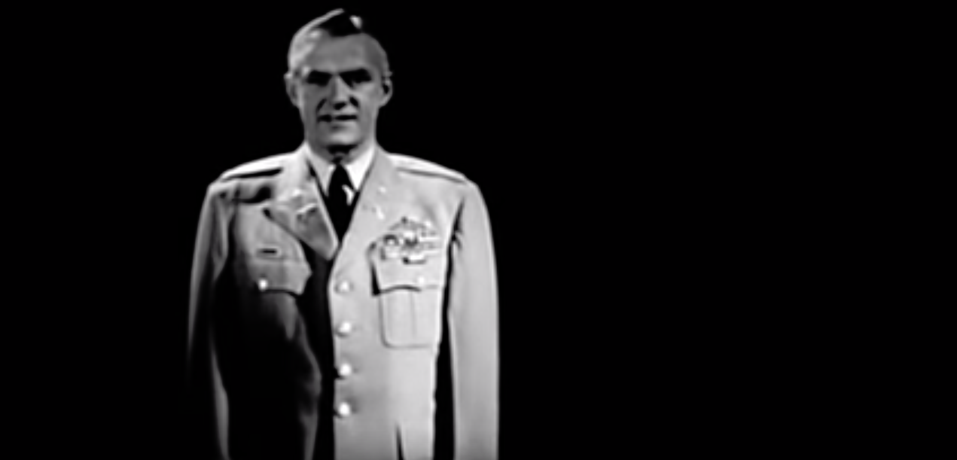
Into (0:50)
The film starts and the viewer is surprised for the first time: The national rifle association (NRA) produced a movie and endorses it… in a Michael Moore movie?
Not sure what to expect…it has to be cynical?

Slide 5
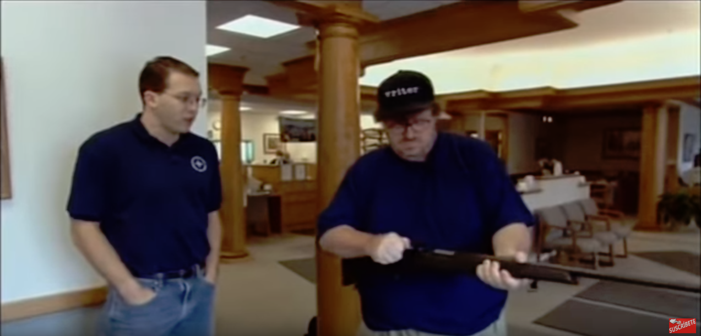
Ordinary World (1:00)
The NRA approved movie starts and Michael Moore is showing us the typical day of a US American: Doing some farm work, delivering the milk and bombing a foreign country… what a lovely day!
He then walks into a bank to get a free rifle in return for opening a new bank account (One if not the most famous scene of the movie) → We start to realize what absurdity the movie will show us
We are curious and awaiting the next scene → The world is established

Slide 6
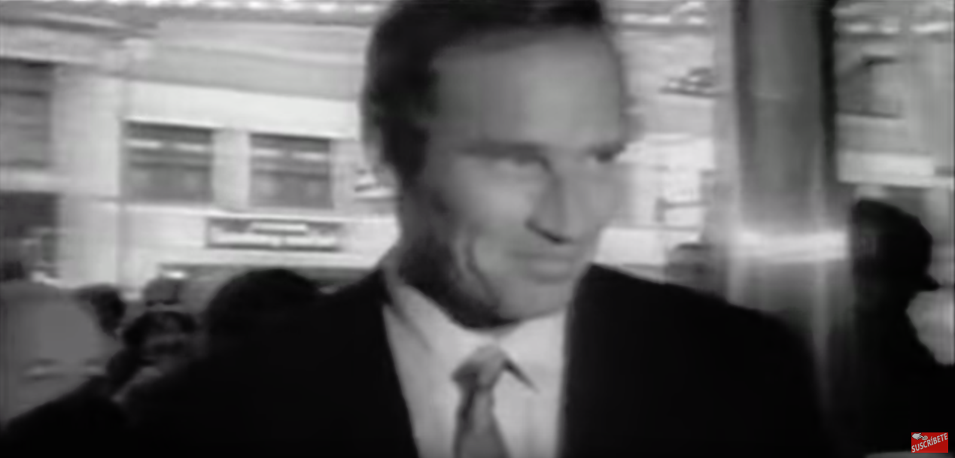
Meeting the enemy (5:00)
Michael More is showing us his childhood. He was a good shooter and grew up in a gun-known world, but still isn’t a gun nut today
For the first time we see the not yet known enemy number one: Charlton Heston (For a long time he was a democrat and a famous movie star!)
In the next few minutes we meet the Michigan militia and understand the dimensions guns will have. How does Charlton Heston relate to this? → Building up tension, showing the enemies

Slide 7
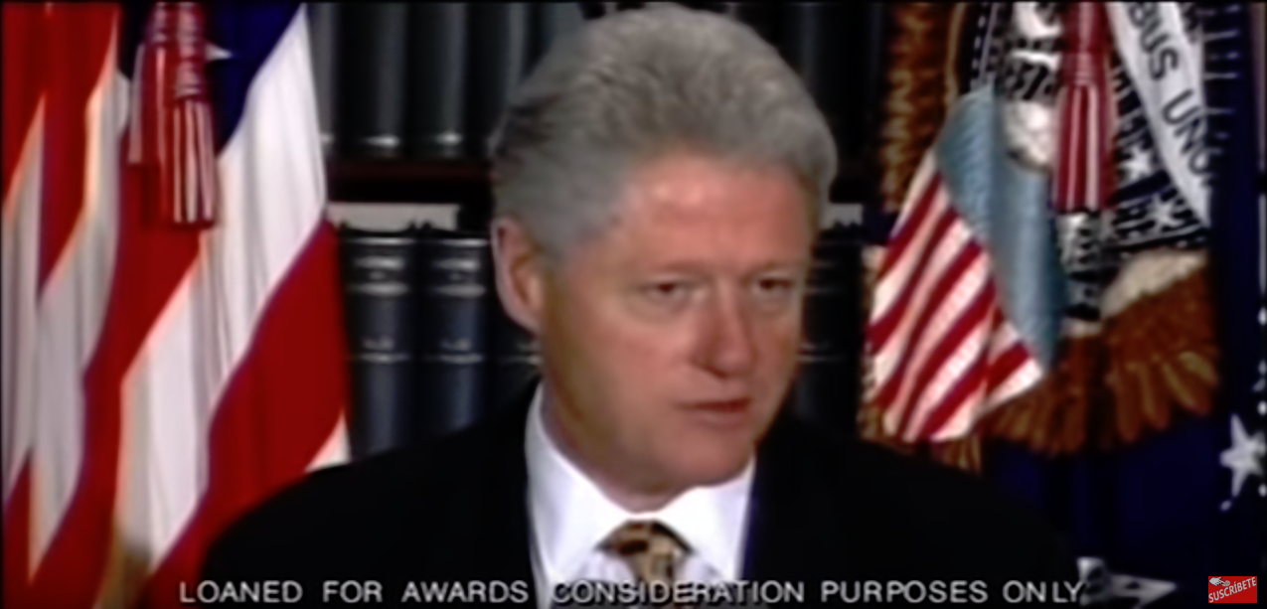
Crossing the first threshold (29:38)
We hear from the war in the Kosovo where several civilians in hospitals and schools were killed by US NATO bombs – a normal day in the US, people don’t really care … it’s somewhere over in Europe, why should we care?
One hour later: A “terrible” school shooting in Columbine where several people were killed. It escalates → It’s completely different, because it’s happening in the own country
In the scene afterwards, we see Charlton Heston on an NRA rally → The enemy appears & is mobilizing the gun crowd

Slide 8
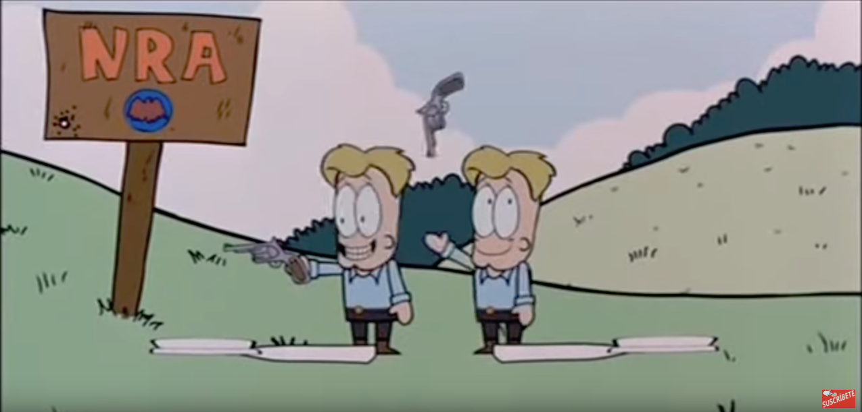
Approaching Inmost Cave (52:43)
In a carton from South Park, the US American history is shown
Now we understand the biggest fear of US Americans: Black people (Oh I love the irony in the carton)
In addition, the biggest “real” enemies are established: The Ku Klux Klan (KKK) and the National Rifle Association (NRA)
From now one black people and the NRA will serve as enemy number one (Note: Only the later one is a real enemy)

Slide 9
Approaching Inmost Cave (52:43)
In the scenes after 52:43 many more enemies and fears are established or enforced (Black people, indigenous people, free health care, sharks, killer bees and razor blades in apples etc.)
We start to realize that US Americans are shifting from one fear into the next one – a dangerous thing: Always fighting to survive (Michael Moore calls this the “Climate of fear”)
People become more accessible for radical movements like the KKK or the NRA → The tension is rising

Slide 10
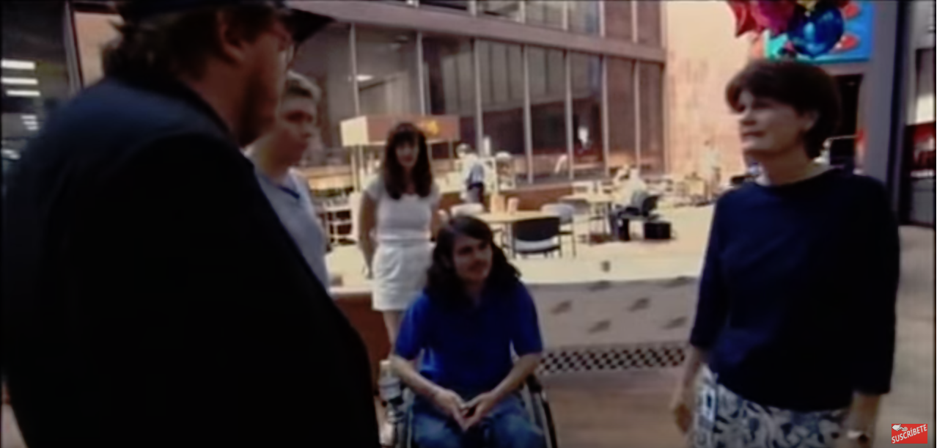
Inmost Cave (1:22:38)
The movie is refocusing on gun violence like the shooting of Kayla Rolland in Mount Morris (A 6 year old first grader kills a girl at school with a gun)
In addition we see the scene were Michael Moore is requesting a refund from Kmart for the remaining bullets in Mr. Mark Taylor’s body (The Columbine terrorists bought the ammunition there) → After buying all ammunition from a store, Kmart is removing handgun ammunition from their stores
Michael Moore says [in disbelief]: "We've won” → Is it over?

Slide 11
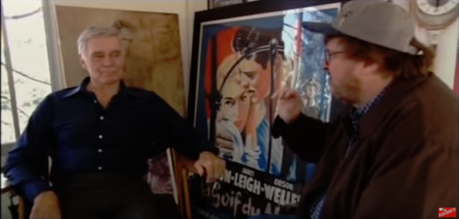
Final & Seizing the sword (1:47:53)
No, the final begins: Disguised as a NRA member (Which he is), Michael Moore is visiting Charlton Heston with a TV crew
They discuss American firearm violence and Moore askes Heston if he would apologize for leading the NRA rallies in Flint after the shooting, knowing about the shooting
Heston defends himself and walks away, Moore following him and shows a picture of the 6 year old killed Kayla. Heston Walks away and Moore leaves a picture of her → In which movie can an arch enemy disappear so easily?

Slide 12
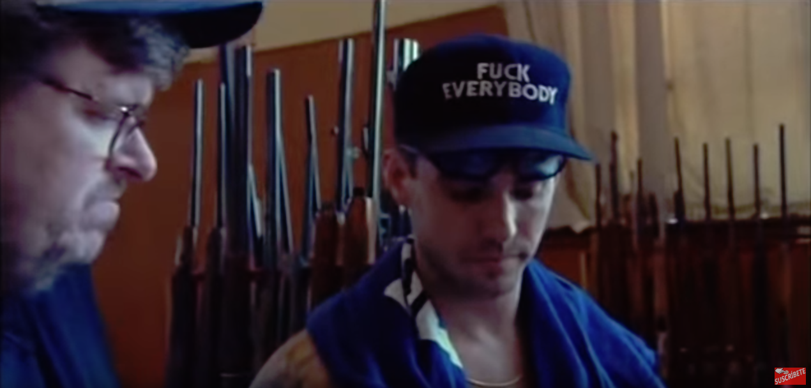
Return with the Elixir (1:56:36)
The hero “Michael Moore” has won… really? What did he gain?
We see the outro - everything will continue the way it did before (No change)
In some DVD cuts, we see an additional outro in memory of three people that all died in gun related circumstances before or during the movie:
John Albers: Hired sound designer and mixer, committed suicide before the movie started
Herbert Cleaves, Jr: Killed in a drive by shooting
Laura Wilcox: Victim of a handgun violence who was murdered
In the end: We won nothing

